Slide 1
Liabilities of Directors under Labour Laws
Workshop Organized by Confederation Of Indian Industry Madhya Pradesh Chapter
On 18th August 2015
At ABV Indian Institute of Information Technology, Gwalior
By Advocate Anil Chawla Senior Partner, Anil Chawla Law Associates LLP www.indialegalhelp.com
This Presentation gives only an indication of penalties and liabilities regarding selected labour laws of India.

Slide 2
Key Labour Laws
Employees’ State Insurance Act, 1948
Employees’ Provident Funds Family Pension Fund and Deposit Linked Insurance Fund Act, 1952
The Minimum Wages Act, 1948
The Payment of Bonus Act, 1965
The Payment of Wages Act, 1936
The Payment of Gratuity Act, 1972
Contract Labour (Regulation and Abolition) Act, 1970
The Maternity Benefit Act, 1961
The Industrial Employment (Standing Orders) Act, 1946

Slide 3
A. Key Concepts
A1. Occupier under Factories Act
A2. Exemption of Occupier or Manager
A3. Recovery as Arrears of Land Revenue

Slide 4
A1. Occupier under Factories Act
Section 2(n) and 7(1) of Factories Act, 1948

Slide 5
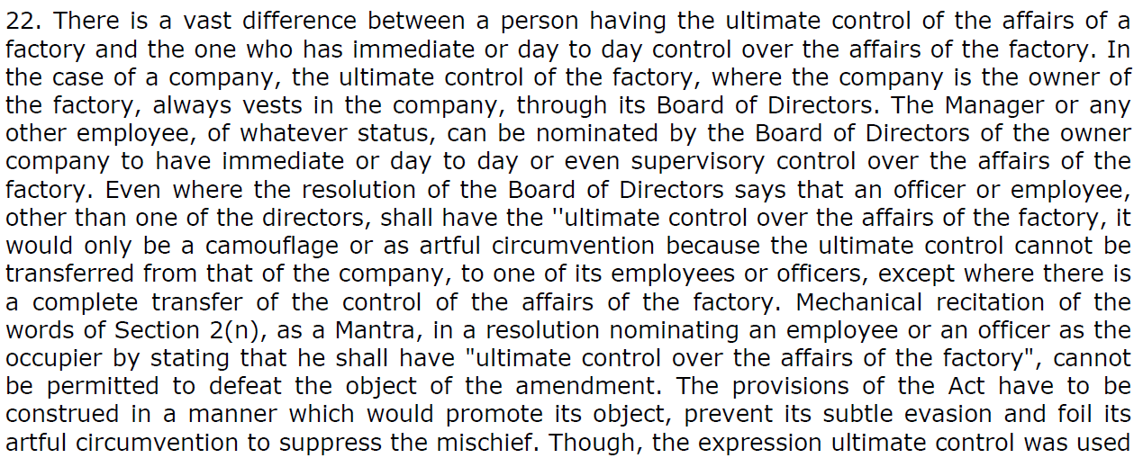
A1. Occupier under Factories Act (Continued)
J.K. Industries Ltd. and Ors. Vs. Chief Inspector of Factories and Boilers and Ors., MANU/SC/1293/1996

Slide 6
A1. Occupier under Factories Act (Continued)
J.K. Industries Ltd. and Ors. Vs. Chief Inspector of Factories and Boilers and Ors., MANU/SC/1293/1996

Slide 7
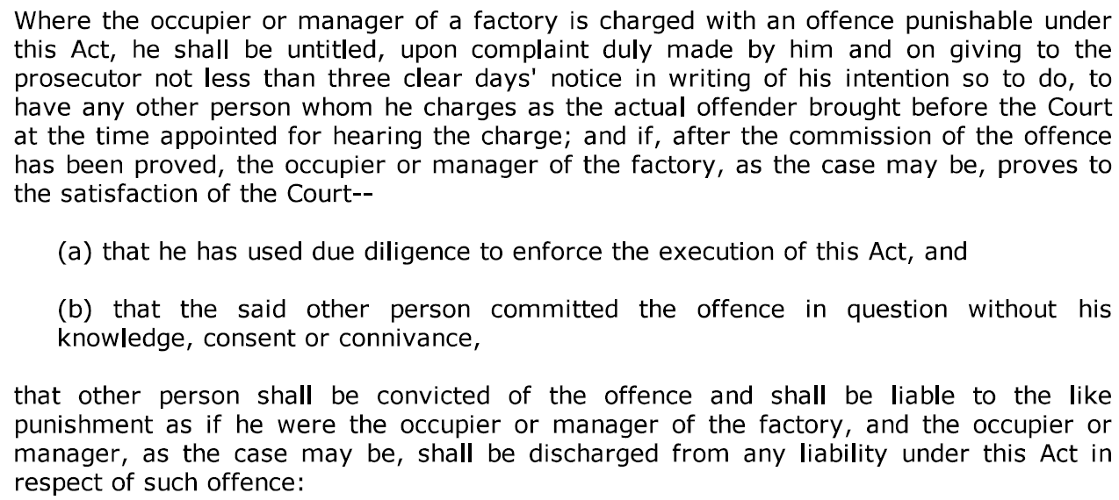
A2. Exemption of Occupier or Manager
Section 101 of Factories Act, 1948

Slide 8
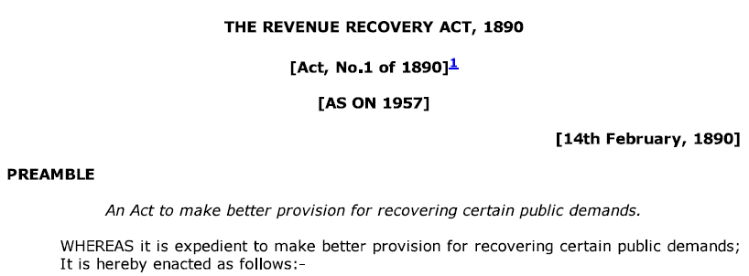
A3. Recovery as Arrears of Land Revenue
Section 6(1) of The Revenue Recovery Act, 1890

Slide 9
B. Employees State Insurance Act
B1. Principal Employer
B2. ESI Dues as Land Revenue
B3. Punishment for False Statement
B4. Punishment for Failure to Pay
B5. Offences by companies
B6. Repeated offences

Slide 10
B1. Principal Employer
Section 2(17) of ESI Act, 1948

Slide 11
B2. ESI Dues as Land Revenue

Slide 12
B3. Punishment for False Statement
Section 84 of ESI Act, 1948

Slide 13
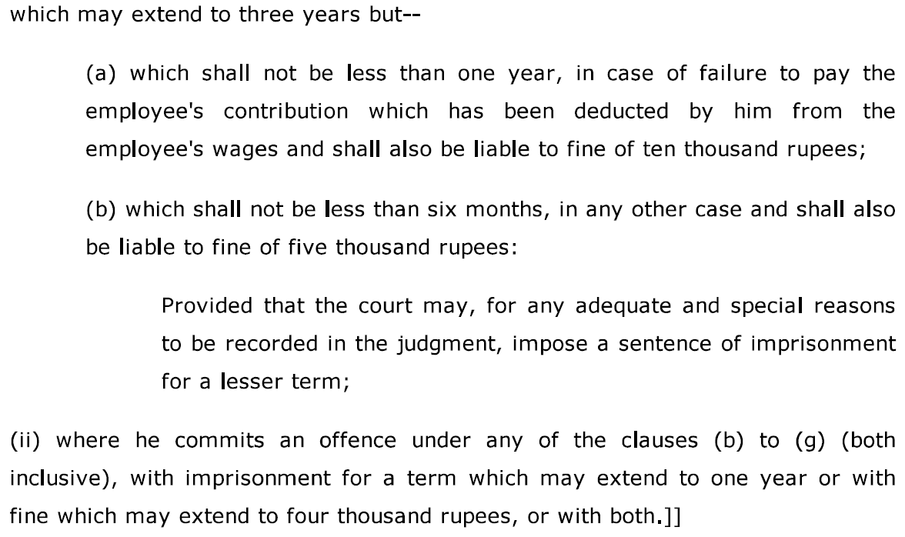
B4. Punishment for failure to pay
Section 85 of ESI Act, 1948

Slide 14
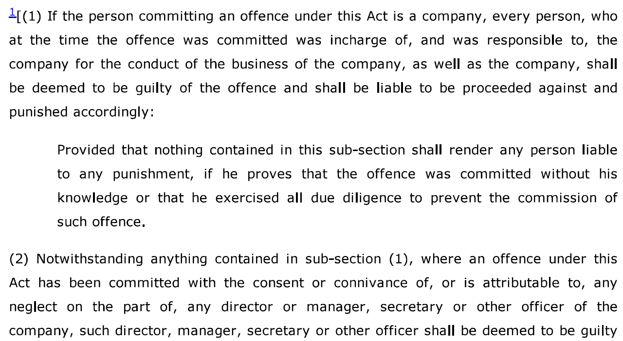
B5. Offences by companies
Section 86A of ESI Act, 1948

Slide 15
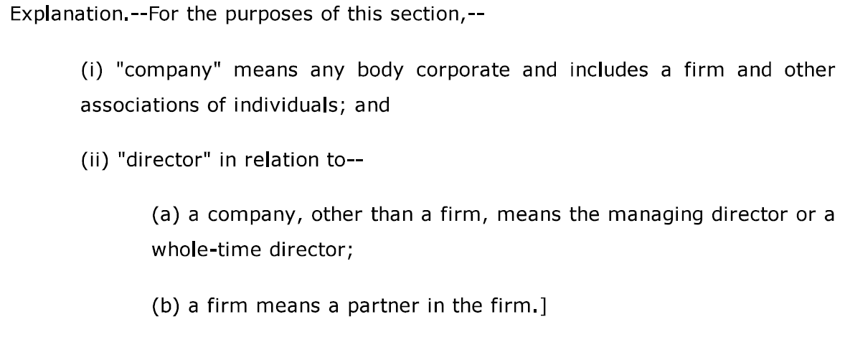
B5. Offences by companies (Continued)
Section 86A of ESI Act, 1948

Slide 16
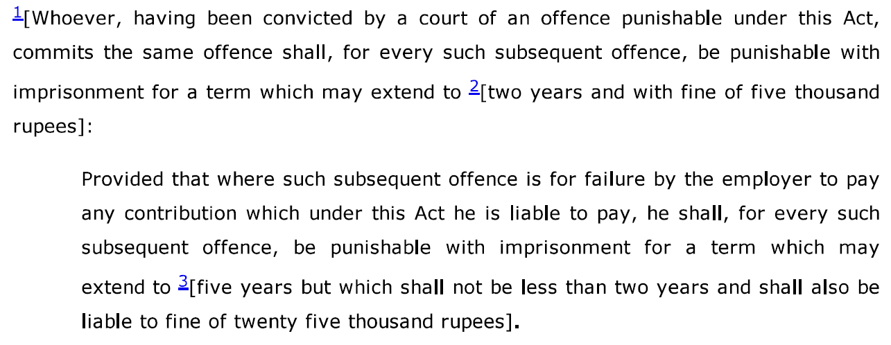
B6. Repeat offences
Section 85A of ESI Act, 1948

Slide 17
C. Provident Fund
C1. Employer
C2. Recovery of Moneys as Land Revenue
C3. Penalties
C4. Offences by Companies
C5. Repeat Offences and Cognizable Offence

Slide 18
C1. Employer
Section 2(e) of Employees’ Provident Funds Family Pension Fund and Deposit Linked Insurance Fund Act, 1952

Slide 19
C2. Recovery of moneys as land revenue
Section 8 of Employees’ Provident Funds Family Pension Fund and Deposit Linked Insurance Fund Act, 1952

Slide 20
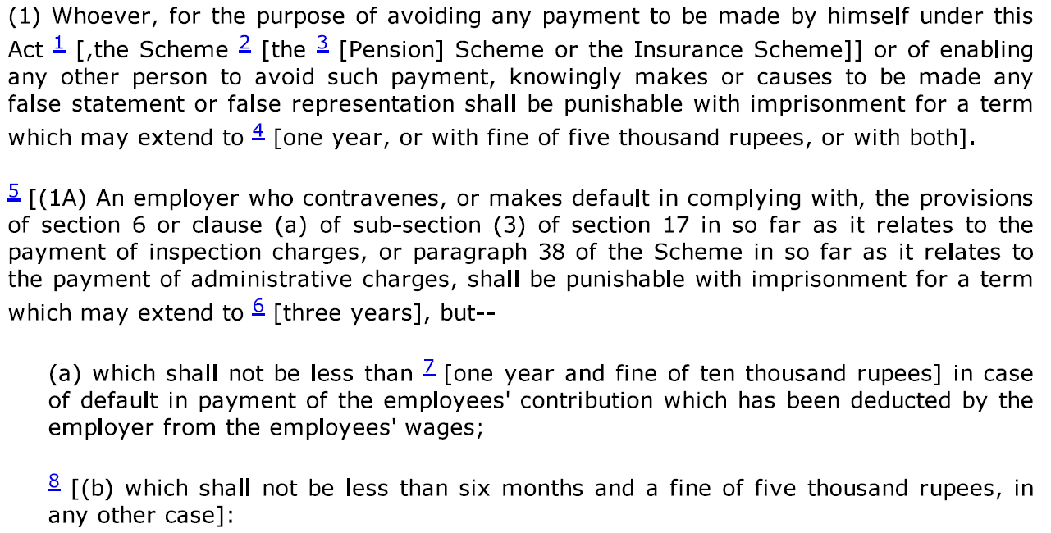
C3. Penalties
Section 14 of Employees’ Provident Funds Family Pension Fund and Deposit Linked Insurance Fund Act, 1952

Slide 21
C3. Penalties (Continued)
Section 14 of Employees’ Provident Funds Family Pension Fund and Deposit Linked Insurance Fund Act, 1952

Slide 22
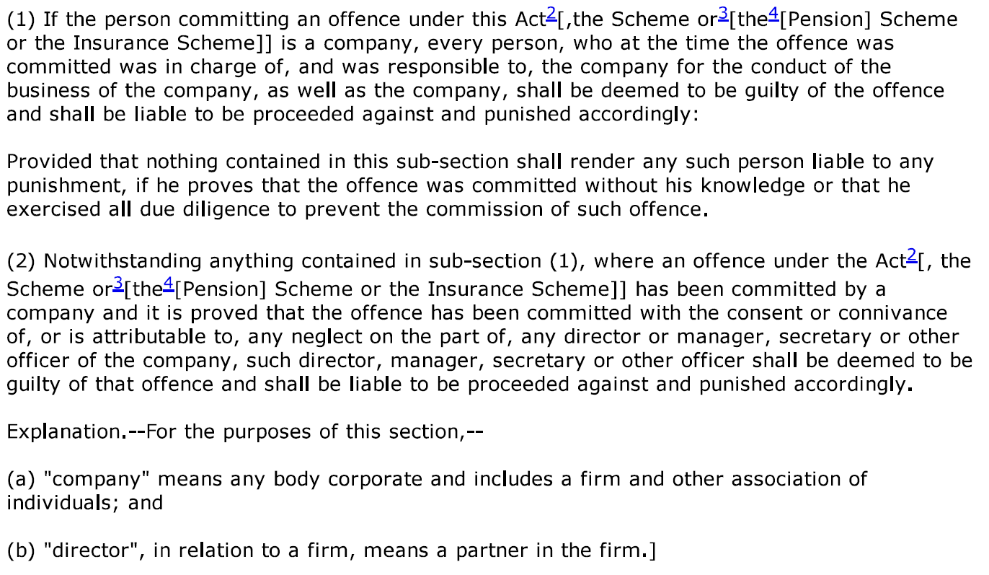
C4. Offences by companies
Section 14A of Employees’ Provident Funds Family Pension Fund and Deposit Linked Insurance Fund Act, 1952

Slide 23
C5. Repeat Offence & Cognizable Offence
Section 14A A & 14AB of Employees’ Pr. Funds Family Pension Fund and Deposit Linked Insurance Fund Act, 1952

Slide 24
D. Minimum Wages
D1. Employer
D2. Penalties
D3. Offences by Companies

Slide 25
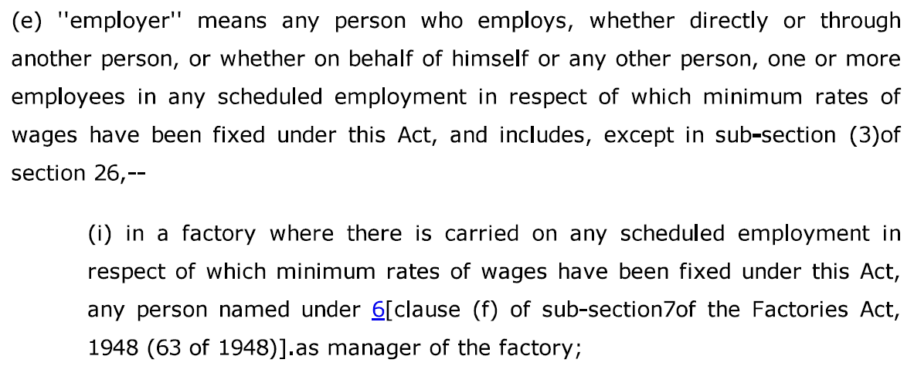
D1. Employer
Section 2(e) of The Minimum Wages Act, 1948

Slide 26
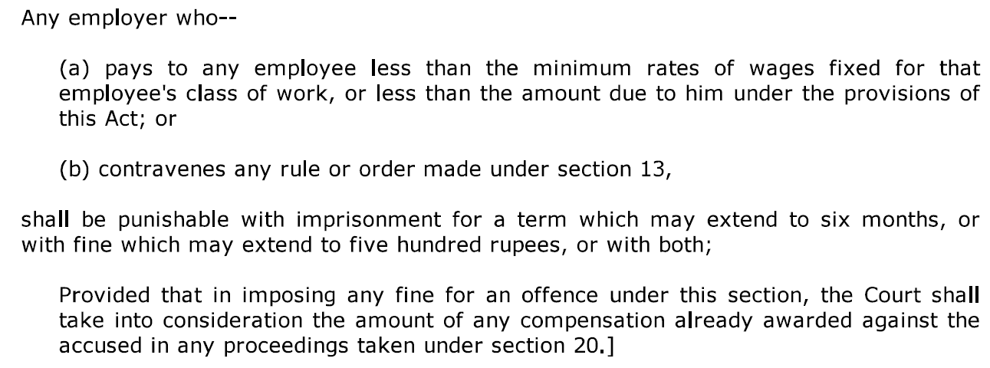
D2. Penalties
Section 22 of The Minimum Wages Act, 1948

Slide 27
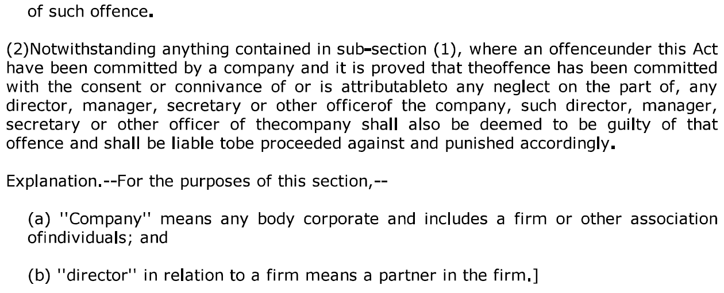
D3. Offences by companies
Section 22C of The Minimum Wages Act, 1948

Slide 28
E. Payment of Bonus
E1. Employer
E2. Penalties
E3. Offences by Companies

Slide 29
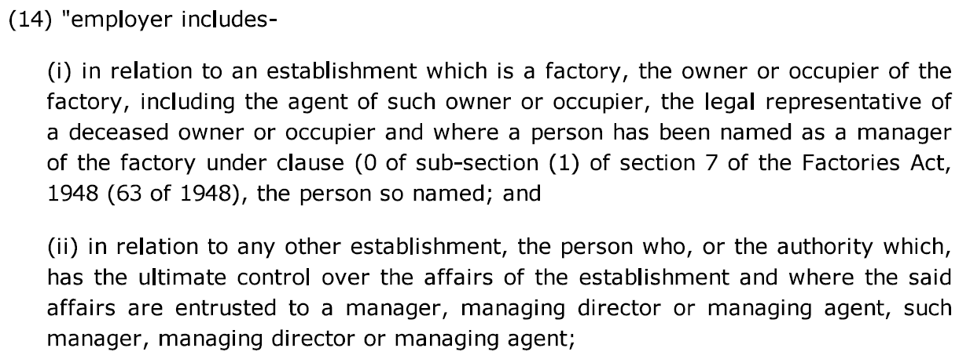
E1. Employer
Section 2(14) of The Payment of Bonus Act, 1965

Slide 30
E2. Penalties
Section 28 of The Payment of Bonus Act, 1965

Slide 31
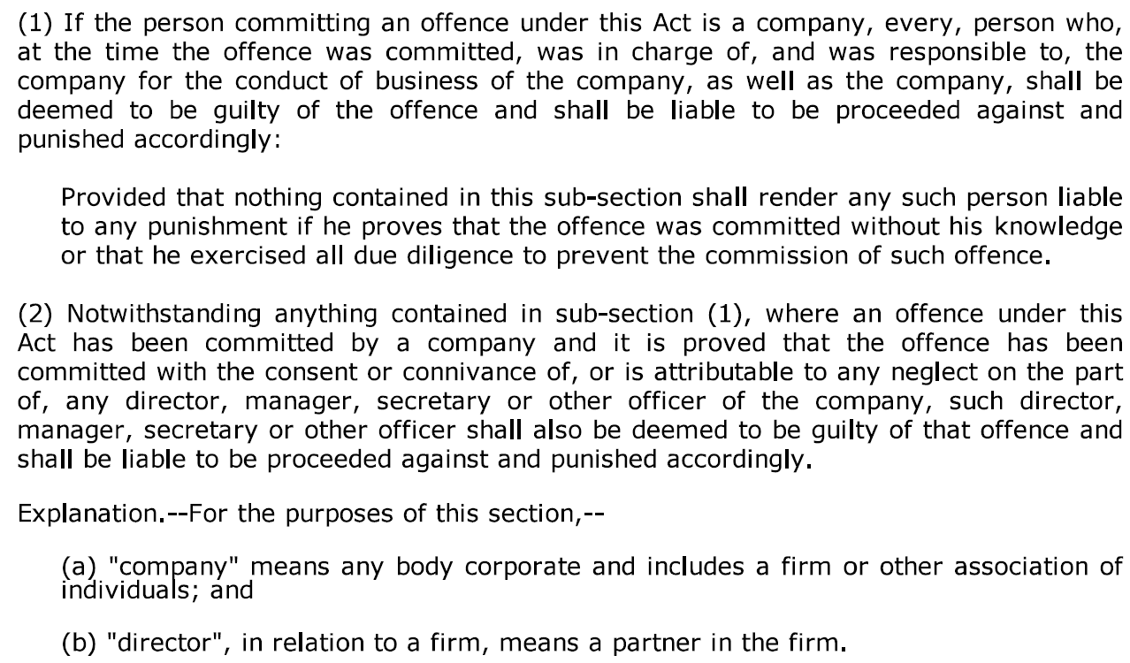
E3. Offences by companies
Section 29 of The Payment of Bonus Act, 1965

Slide 32
Thanks!
Anil Chawla Law Associates LLP
www.indialegalhelp.com
info@indialegalhelp.com Tel. – 09425009280
Anil Chawla Law Associates LLP is registered with limited liability and bears LLPIN AAA‑8450.
This Presentation is an academic exercise. It does not offer any advice or suggestion to any individual or firm or company. While all efforts have been made to ensure accuracy and correctness of information provided, no warranties / assurances are provided or implied. Readers are advised to consult a Legal Professional / Company Secretary / Chartered Accountant before taking any business decisions. Anil Chawla Law Associates LLP does not accept any liability, either direct or indirect, with regard to any damages / consequences / results arising due to use of the information contained in this Presentation.

