Slide 1
Liabilities of Directors under Negotiable Instruments Act, 1881
Second Edition – June 2017 First Edition – August 2015
Anil Chawla Law Associates LLP www.indialegalhelp.com
Anil Chawla Law Associates LLP is registered with limited liability and bears LLPIN AAA‑8450.
This Presentation is an academic exercise. It does not offer any advice or suggestion to any individual or firm or company. While all efforts have been made to ensure accuracy and correctness of information provided, no warranties / assurances are provided or implied. Readers are advised to consult a Legal Professional / Company Secretary / Chartered Accountant before taking any business decisions. Anil Chawla Law Associates LLP does not accept any liability, either direct or indirect, with regard to any damages / consequences / results arising due to use of the information contained in this Presentation.
Copyright – Anil Chawla Law Associates LLP, 2017
This Presentation gives an indication of law applicable to prosecution of directors of a company in case of bouncing of cheque..

Slide 2
Quick Overview
Vicarious Liability - rare case of vicarious criminal liability
Director responsible only if he is active
Non-executive and independent directors not liable
Managing Director, Executive Director, Joint Managing Director, Whole-time Director presumed to be liable
Quick and almost certain prosecution unless carefully defended

Slide 3
A. Relevant Sections of NI Act
A1. Section 138
A2. Section 141
A3. Key Points of Section 141

Slide 4
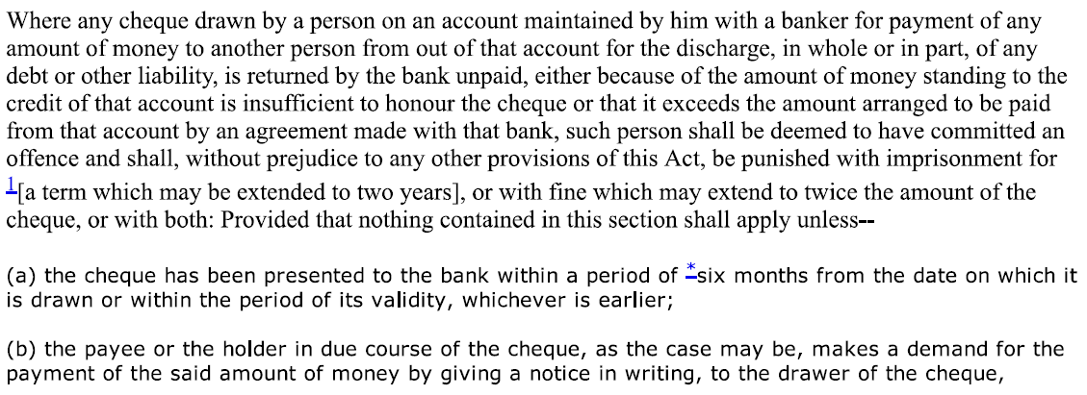
A1. Section 138

Slide 5
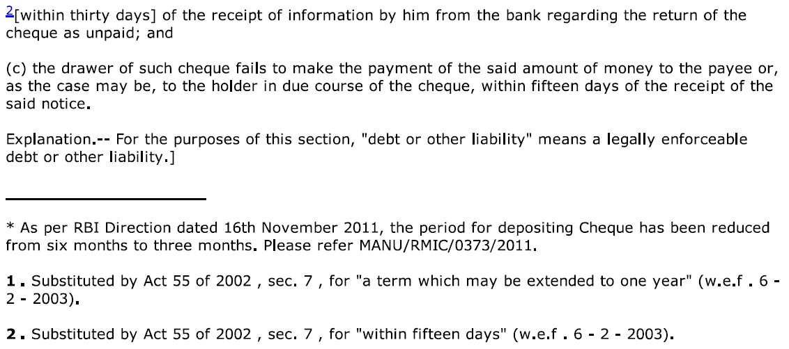
A1. Section 138 (Continued)

Slide 6
A2. Section 141

Slide 7
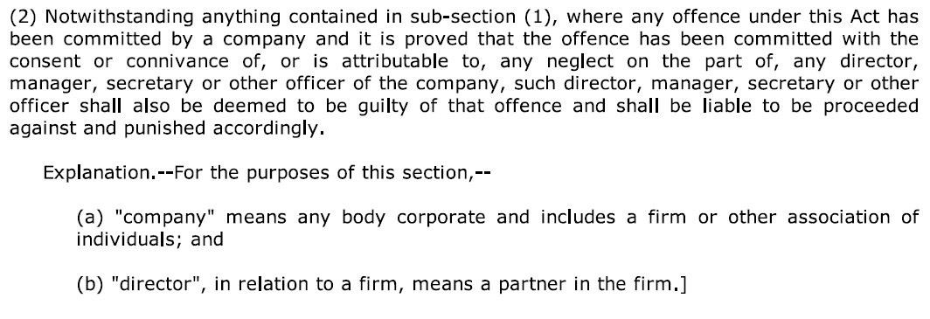
A2. Section 141 (Continued)

Slide 8
A3. Key Points of Section 141
Director should be in charge of AND be responsible to the company for the conduct of the business of the company
Not responsible if he proves that the offence was committed without his knowledge OR that he had exercised all due diligence to prevent the commission of the offence

Slide 9
B. Key Provisions of Case Law
B1. Key Principles
B2. Company Must be Liable for Director to be Liable
B3. Directors Need Not be Served Notice
B4. Specific Averment Necessary

Slide 10
B1. Key Principles

Slide 11
B1. Key Principles (Continued)
National Small Industries Corp. Ltd. vs. Harmeet Singh Paintal and another, MANU/SC/0112/2010

Slide 12
B2. Company Must be Liable for Director to be Liable
Applying the doctrine of strict construction, we are of the considered opinion that commission of offence by the company is an express condition precedent to attract the vicarious liability of others. Thus, the words "as well as the company“ appearing in the Section make it absolutely unmistakably clear that when the company can be prosecuted, then only the persons mentioned in the other categories could be vicariously liable for the offence subject to the averments in the petition and proof thereof.
Aneeta Hada v. Godfather Travels and Tours Pvt. Ltd., MANU/SC/0335/2012

Slide 13
B3. Director need not be served notice
Krishna Texport and Capital Markets Ltd. v. Ila A Agrawal and Ors., MANU/SC/0562/2015

Slide 14
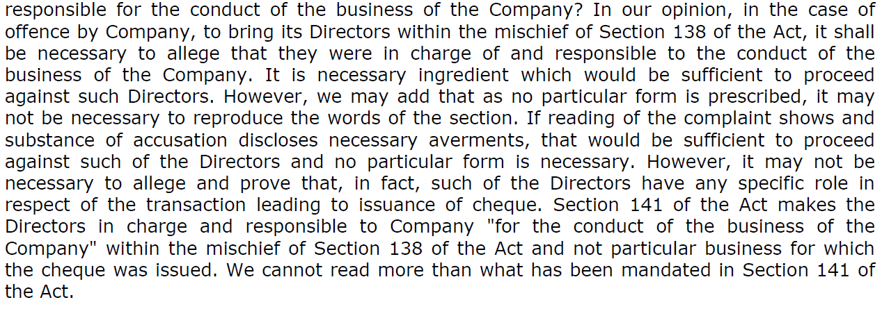
B4. Specific Allegation Necessary
A.K. Singhania v. Gujarat State Fertilizer Co. Ltd. and Anr., MANU/SC/1081/2013

Slide 15
C. Position of Independent Directors
C1. Who is Independent Director
C2. Liability of Independent Directors under Companies Act
C3. Position of Independent Director under NI Act
C4. Companies Act vs. NI Act
C5. Suggested Action Points

Slide 16
C1. Who is Independent Director
Independent Director is a new class of directors introduced by Companies Act, 2013.
Independent director must not be related in any way to promoter(s), key managerial personnel and other director(s).
Independent director should not be a shareholder of the company.
Independent director must meet the criterion of independence as defined under section 149(6) of the Companies Act, 2013.
It is necessary for listed public companies to appoint independent directors.
As and when a person is appointed as an independent director of a company, this is duly mentioned in the form DIR12 filed with Registrar of Companies. So, there is no confusion whether a person is independent director or not.

Slide 17
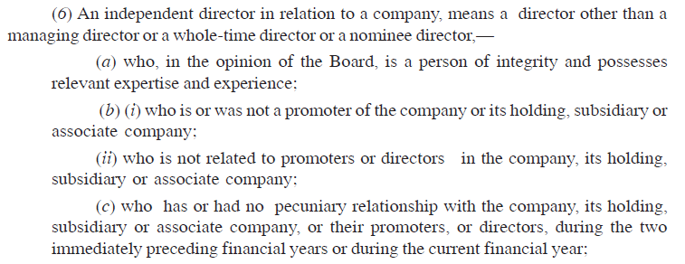
C1. Who is Independent Director (Continued)
Section 149(6) of The Companies Act, 2013

Slide 18
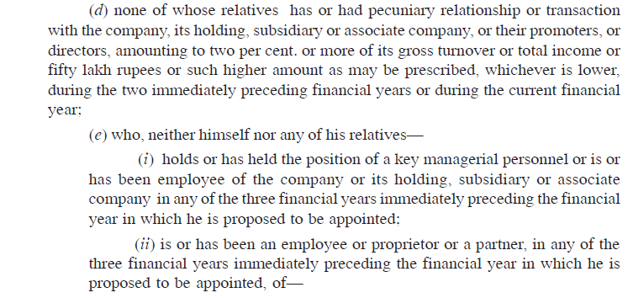
C1. Who is Independent Director (Continued)
Section 149(6) of The Companies Act, 2013

Slide 19
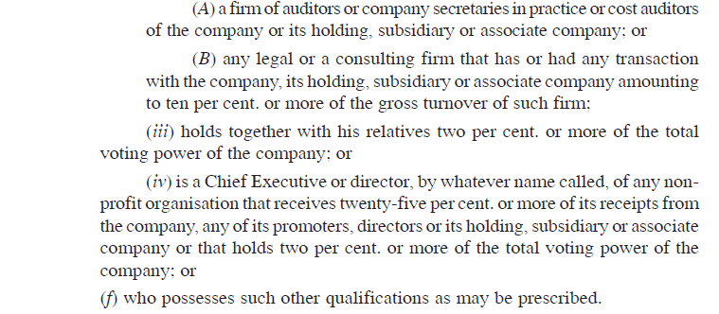
C1. Who is Independent Director (Continued)
Section 149(6) of The Companies Act, 2013

Slide 20
C2. Liability under Companies Act
Independent Director (ID) liable only when:
Acts of omission or commission by the company done with ID’s knowledge
ID’s knowledge ought to be attributed to ID through processes of Board of Directors. So knowledge obtained through other sources such as newspaper etc. will not count.
In addition to knowledge, there must be one of three – (a) consent or (b) connivance or (c) absence of diligence in ID’s actions.

Slide 21
C2. Liability under Companies Act (Continued)
Section 149(12) of The Companies Act, 2013

Slide 22
C3. Position under NI Act
It must be presumed that the independent director (ID) was:
NOT “in charge of the company” AND
NOT “responsible to the company for the conduct of the business of the company”.
Hence, unless strong evidence exists to the contrary, it is difficult or inappropriate to apply section 141 of NI Act in case of independent director.
Additional defense of ID will be that the offence was committed without his knowledge.
Any knowledge will be hurtful for ID even though the knowledge was not acquired through Board process.

Slide 23
C4. Companies Act vs. NI Act
Nature of independent director (ID) as defined under Companies Act helps ID against prosecution under NI Act since by definition ID cannot be “in charge of the company”.
Under Companies Act, an ID can be prosecuted merely on the basis of knowledge acquired in Board combined with tacit consent.
Under NI Act, while absence of knowledge is a valid defense, knowledge by itself is not sufficient to make the ID liable.
Under NI Act, it should be presumed that ID is not in charge of the company and is not responsible for the business of the company and is not covered under section 141. No such presumption under Companies Act.
The above position will need to be confirmed by some court judgments.

Slide 24
C5. Suggested Action Points
If you are an independent director of a company and you receive a notice about bouncing of a cheque issued by the company, the following action points are suggested:
You should reply promptly to the notice stating that you are an independent director and that you are not in charge of the company and you are not responsible for the business of the company.
Do not rely on the company lawyer to defend you.
From the outset defend yourself independent of the company and its executive director(s).
Remember that the company, its Managing Director, Executive Director etc. have often no way to save themselves, but you have a good defense. So do not be part of their boat.

Slide 25
Helps you with –
Strategic Advice, International Investment Arbitration, International Commercial Arbitration, Corporate Relationships, Resolving Disputes without Litigation, Structures for Global Business Entities, Research based opinion
We take an entrepreneur’s perspective on every issue.
Seeing our clients' business grow and prosper is our passion.
www.indialegalhelp.com
info@indialegalhelp.com
We follow a transparent system for fees. Please look at our Indicative Rates (http://www.indialegalhelp.com/files/indicativerates.pdf ) before contacting us.

