Slide 1
Liabilities of Directors under
The Companies Act 2013
(As amended by The Companies Amendment Act, 2020)
Fourth Edition – March 2021
First Edition – August 2015
Anil Chawla Law Associates LLP
www.indialegalhelp.com
Anil Chawla Law Associates LLP is registered with limited liability and bears LLPIN AAA‑8450.
This Presentation is an academic exercise. It does not offer any advice or suggestion to any individual or firm or company. While all efforts have been made to ensure accuracy and correctness of information provided, no warranties / assurances are provided or implied. Readers are advised to consult a Legal Professional / Company Secretary / Chartered Accountant before taking any business decisions. Anil Chawla Law Associates LLP does not accept any liability, either direct or indirect, with regard to any damages / consequences / results arising due to use of the information contained in this Presentation.
Copyright – Anil Chawla Law Associates LLP, 2021
This Presentation gives only an indication of the various provisions related to penalties and punishments for Directors under The Companies Act, 2013 of India. It is not intended to be either complete or exhaustive narration of the subject.

Slide 2
Preface
Companies Act, 2013 (the Act) used to be a Draconian law which has been substantially softened after the amendments introduced vide The Companies (Amendment) Act, 2020 (effective from 29th September 2020).
Anti-business bias is apparent even after the softening.
Duties, penalties and punishments continue to be extremely stringent.

Slide 3
A. Some Key Concepts
A1. Officer
A2. Manager
A3. Managing Director
A4. Key Managerial Personnel
A5. Officer in Default

Slide 4
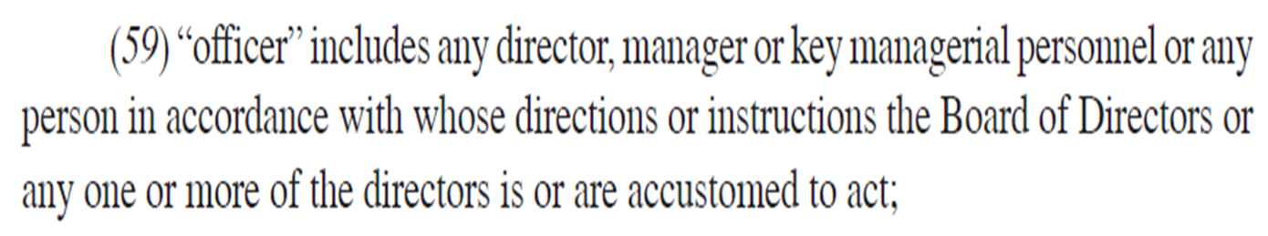
A1. Officer
Section 2(59)

Slide 5
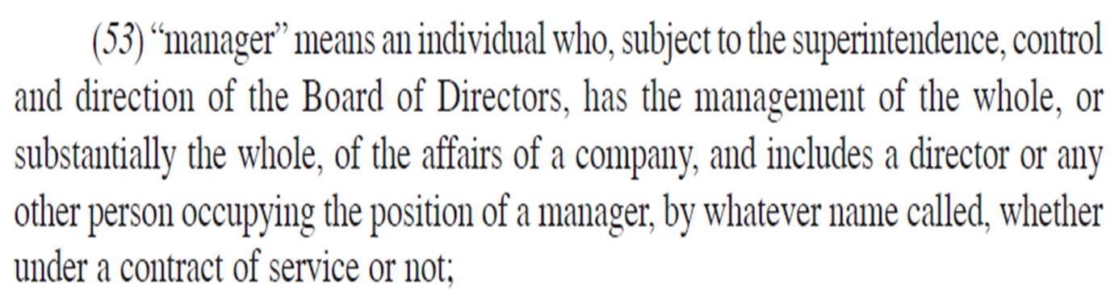
A2. Manager
Section 2(53)

Slide 6
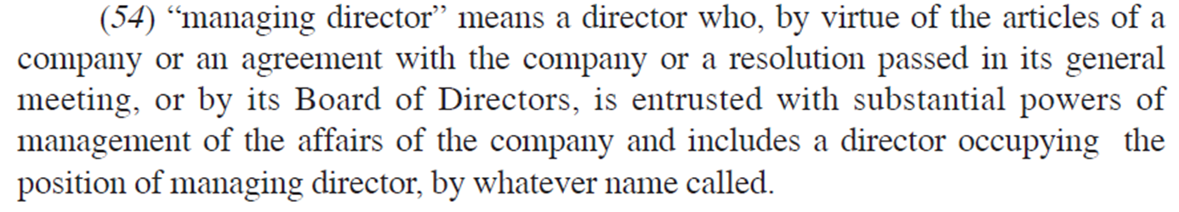
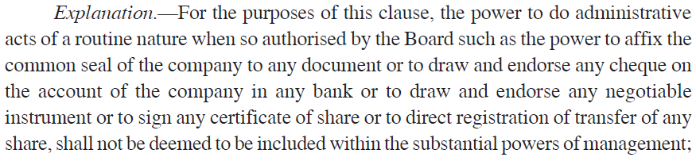
A3. Managing Director
Section 2(54)

Slide 7
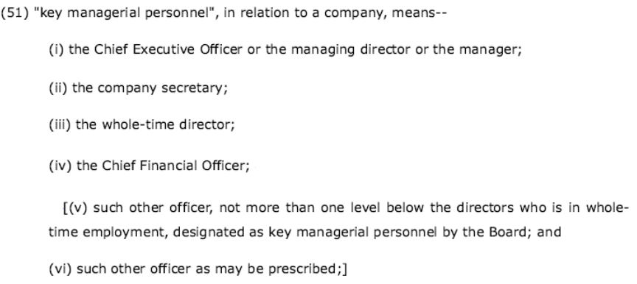
A4. Key Managerial Personnel
Section 2(51), amended in 2020.

Slide 8
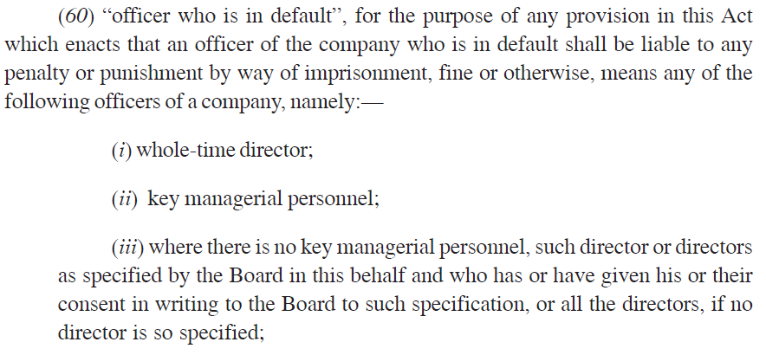
A5. Officer in Default
Section 2(60)

Slide 9
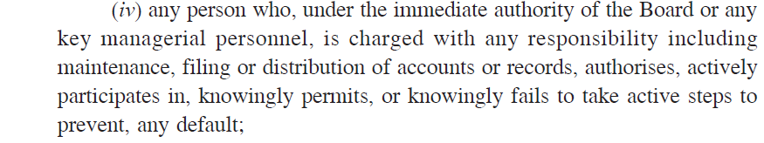
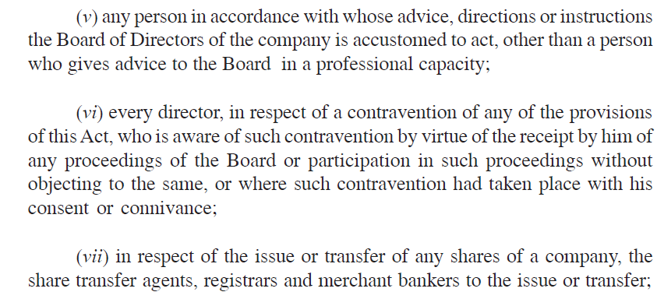
A5. Officer in Default (Continued)
Section 2(60)

Slide 10
B. Some Relevant Provisions
B1. Duties of Directors
B2. Disqualification to be a Director
B3. Cognizable Offences with No Bail
B4. Protection of Independent Directors

Slide 11
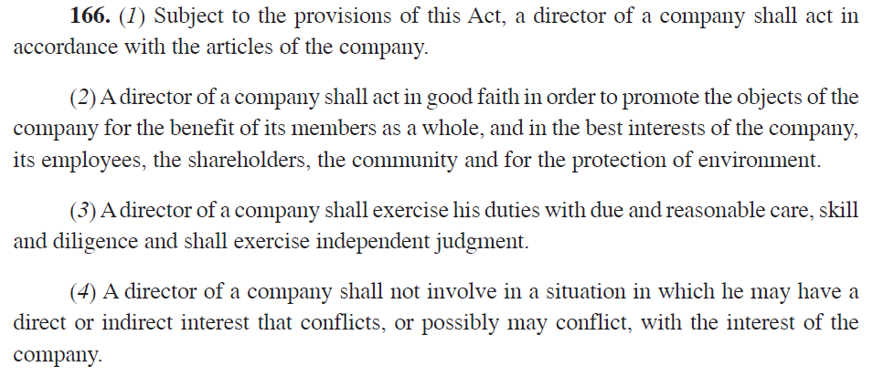
B1. Duties of Director

Slide 12
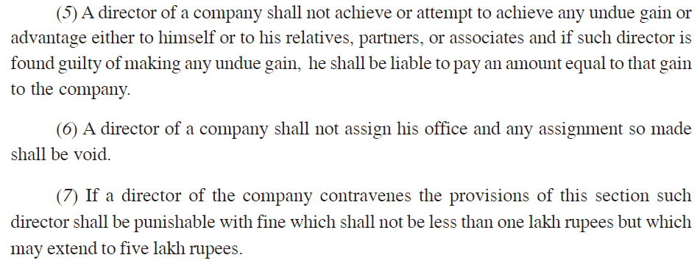
B1. Duties of Director (Continued)
Section 166

Slide 13
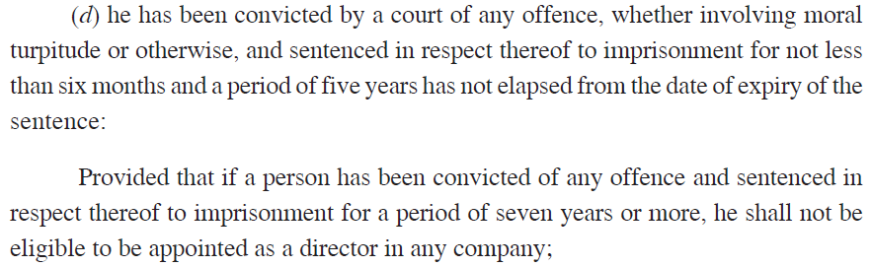
B2. Disqualification to be a Director
Section 164

Slide 14
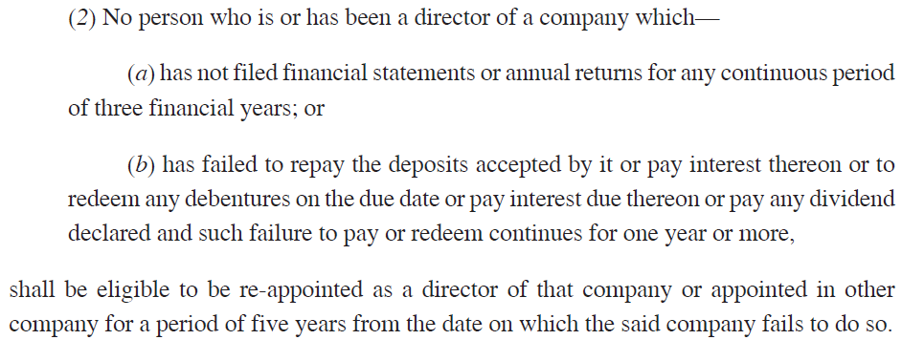
B2. Disqualification to be a Director (Continued)
Section 164

Slide 15
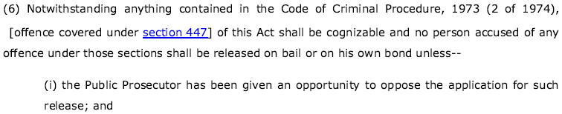
B3. Cognizable Offences Without Bail
Section 212(6)

Slide 16
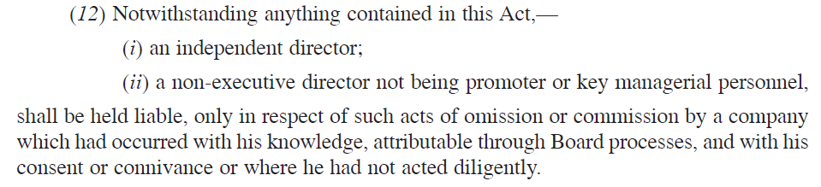
B4. Protection of Independent Directors
Section 149(12)

Slide 17
C. Penalties and Punishments

Slide 18
Chapter II – Incorporation of Company and Matters Incidentals Thereto
Note:
Rs. 1 Lakh = Rs. 100,000 = Rs. 0.1 million
Rs. 1 Crore = Rs. 10,000,000 = Rs. 10 million

Slide 19
Chapter III – Prospectus & Allotment of Securities

Slide 20
Chapter IV – Share Capital & Debentures

Slide 21
Chapter IV – Share Capital & Debentures (Continued)

Slide 22
Chapter V – Acceptance of Deposits

Slide 23
Chapter VI – Registration of Charges

Slide 24
Chapter VII – Management & Administration

Slide 25
Chapter VII – Management & Admin. (Continued)

Slide 26
Chapter VIII – Declaration & Payment of Dividend

Slide 27
Chapter IX – Accounts of Companies
Notes:
*(3) If a company fails to file the copy of the financial statements under sub-section (1) or sub-section (2), as the case may be, before the expiry of the period specified ²¹⁰[therein], the company shall be ²¹¹[liable to a penalty] of ²¹²[ten thousand rupees and in case of continuing failure, with a further penalty of one hundred rupees for each day during which such failure continues, subject to a maximum of two lakh rupees,] and the managing director and the Chief Financial Officer of the company, if any, and, in the absence of the managing director and the Chief Financial Officer, any other director who is charged by the Board with the responsibility of complying with the provisions of this section, and, in the absence of any such director, all the directors of the company, shall be ²¹³[shall be liable to a penalty of ²¹⁴[ten thousand rupees] and in case of continuing failure, with a further penalty of one hundred rupees for each day after the first during which such failure continues, subject to a maximum of ²¹⁵[fifty thousand rupees]].

Slide 28
Chapter X – Audit and Auditors

Slide 29
Chapter XI – Appointment & Qualification of Directors

Slide 30
Chapter XII – Meetings of Board & Its Powers

Slide 31
Chapter XII – Meetings of Board (Continued)

Slide 32
Chapter XIII – Appointment & Remuneration of Managerial Personnel

Slide 33
Chapter XIV – Share Capital & Debentures

Slide 34
Chapter XIV – Share Cap. & Debentures (Continued)

Slide 35
Chapter XVI – Prevention of Oppression & Mismanagement

Slide 36
Chapter XX – Winding Up

Slide 37
Chapter XXVIII – Special Courts

Slide 38
Chapter XXIX – Miscellaneous

Slide 39
Chapter XXIX – Miscellaneous (Continued)

Slide 40

Helps you with –
Strategic Advice, Insolvency Assistance, International Investment Arbitration, International Commercial Arbitration, Corporate Relationships, Resolving Disputes without Litigation, Structures for Global Business Entities, Research based opinion
We take an entrepreneur’s perspective on every issue.
Seeing our clients' business grow and prosper is our passion.
www.indialegalhelp.com
info@indialegalhelp.com
We follow a transparent system for fees. Please look at our Indicative Rates (http://www.indialegalhelp.com/files/indicativerates.pdf ) before contacting us.

